Slide 1
Mistake-Proof Your Code with Fluent Interfaces
Scott Lilly
http://scottlilly.com
scottlilly@scottlilly.com

Slide 2



Tired of writing repetitive code?
Bored to death
writing repetitive code?
PostSharp is trusted by more than 50K developers worldwide.

Slide 3
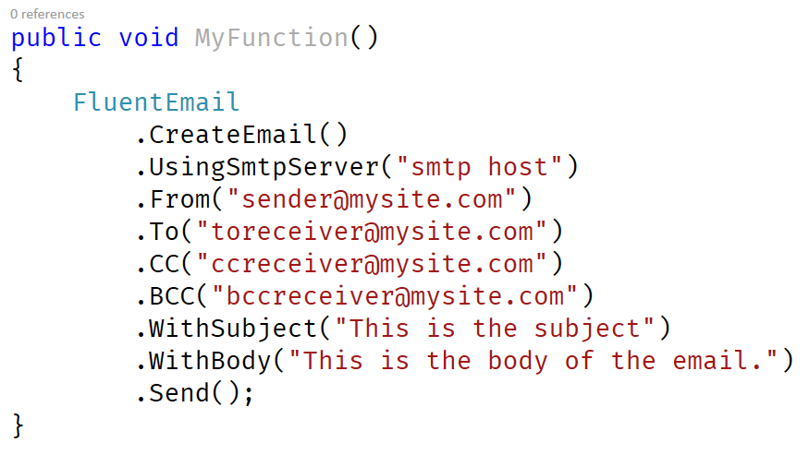
What is a fluent interface?

Slide 4

Question:
How many attempts does it take to plug in a USB device?

Slide 5
Answer:
Three

Slide 6
Why?
Because
USB ports were not designed to be mistake-proof

Slide 7

Be like the power cord
Be mistake-proof

Slide 8
What this webinar will cover
When to use a fluent interface
How to create a fluent interface
Define the ‘vocabulary’ (functions)
Map the ‘grammar’
Write the code

Slide 9
Create a fluent interface when…

Slide 10
Create a fluent interface when…
You want to prevent running potentially-dangerous code

Slide 11
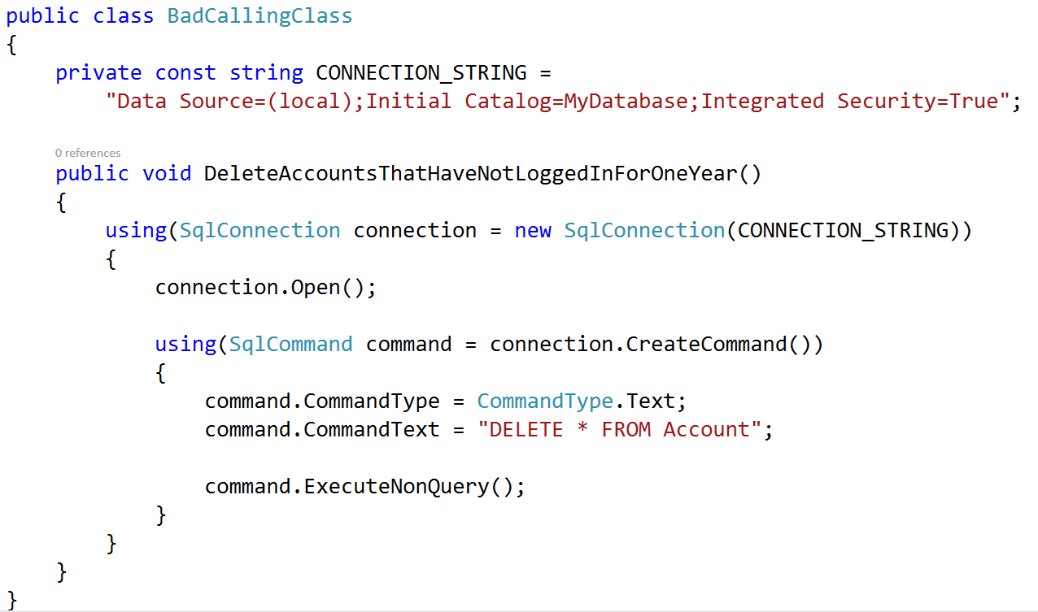
Potentially-dangerous

Slide 12
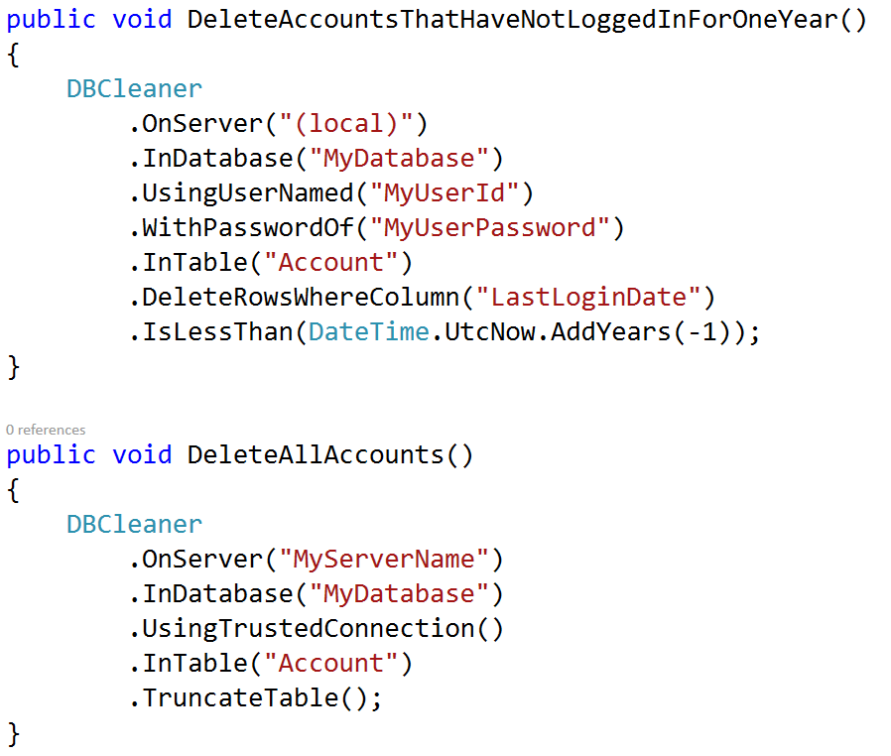
Mistake-proof

Slide 13
Create a fluent interface when…
You want to prevent running potentially-dangerous code
Code must be called in a specific order (hidden requirements)

Slide 14
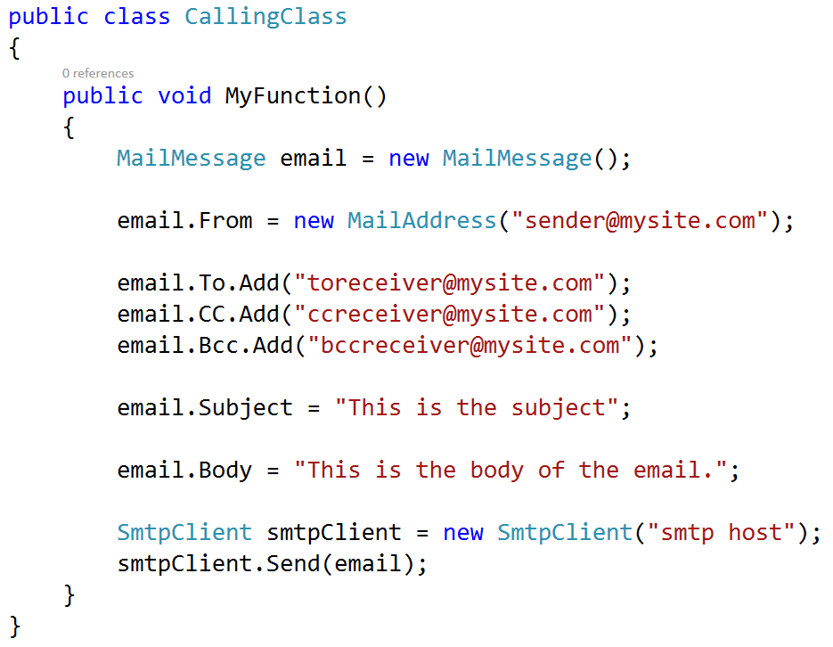
Hidden Requirements

Slide 15
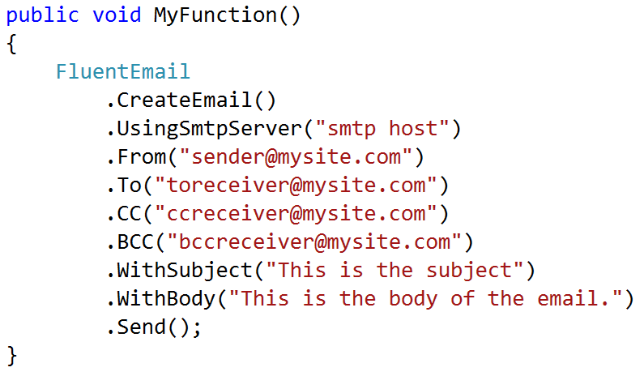
No Hidden Requirements

Slide 16
Create a fluent interface when…
You want to prevent running potentially-dangerous code
Code must be called in a specific order (hidden requirements)
A function has many overloads, almost-overloads, or optional parameters

Slide 17
Now, let’s build our fluent interface

Slide 18
Parts of the vocabulary
I – Instantiating functions
Create the object
C – Chaining functions
Add parameters
E – Ending functions
Perform the action

Slide 19
Building the vocabulary
Instantiating functions
Called once, at the start
Usually have an “action” name
CreateSalesReport()

Slide 20
Building the vocabulary
Chaining functions
Replace passing many parameters
Replace setting properties
From(DateTime from)
To(DateTime to)

Slide 21
Building the vocabulary
Ending functions
Do the desired action
Can return something, or not
BuildReport()

Slide 22
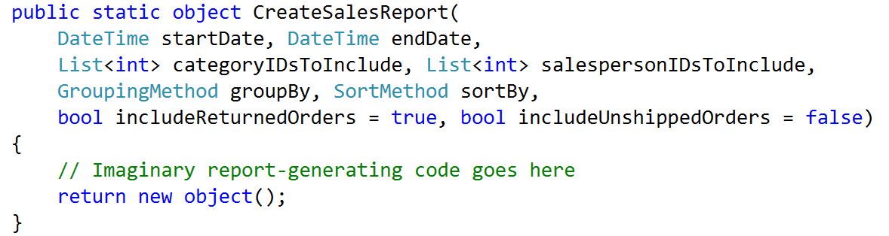
Where to get the chaining functions

Slide 23
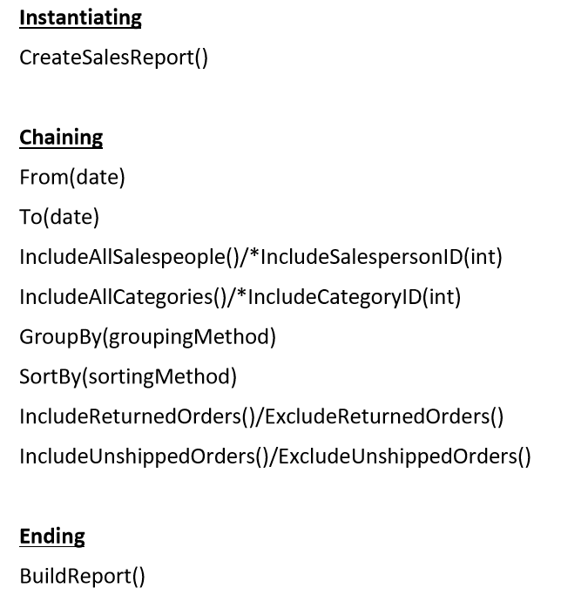

Slide 24
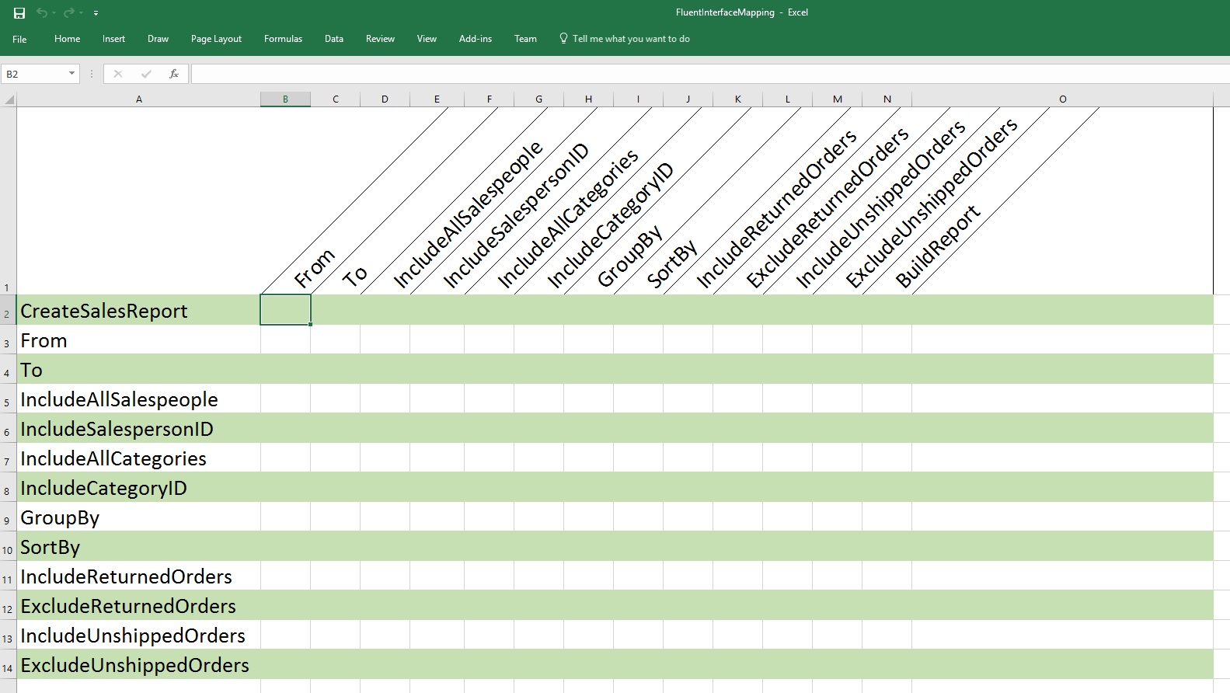
Building the grammar

Slide 26
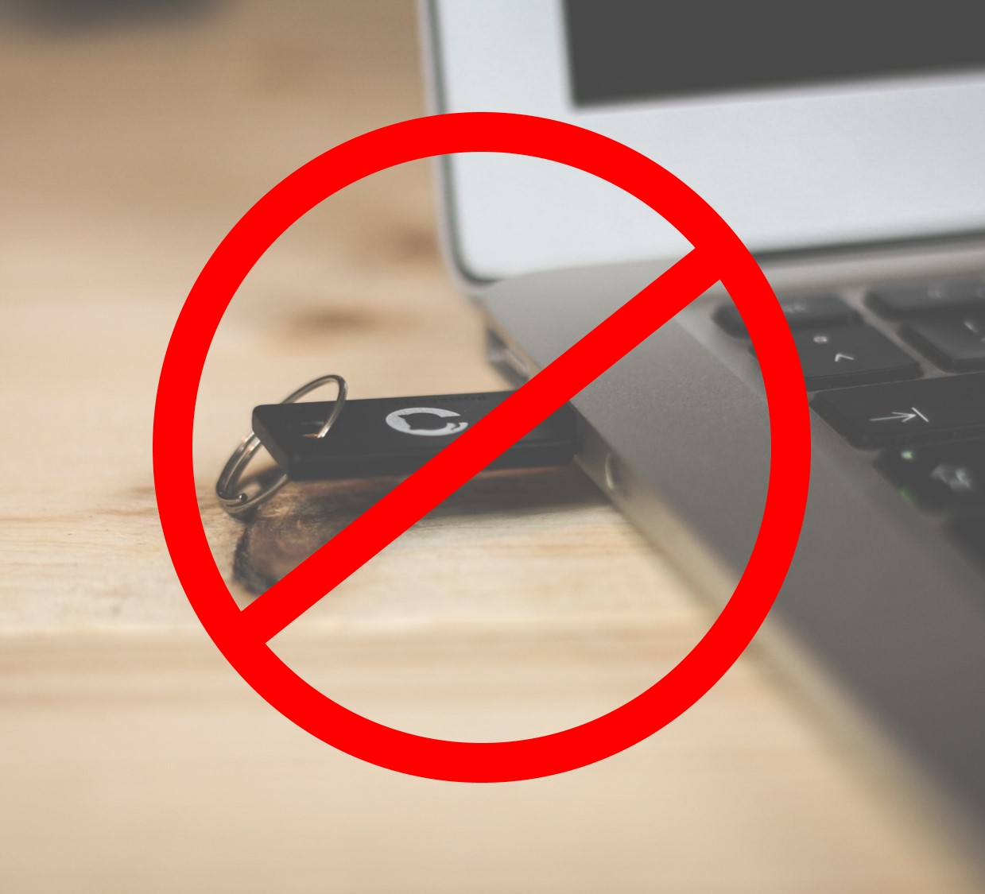
In your next project…
Don’t write mistake-possible “USB” code
Instead, write mistake-proof “power cord” code

Slide 27
Questions?

Slide 28
Get the source code at:
http://scottlilly.com/FIWebinar
http://scottlilly.com
scottlilly@scottlilly.com

